Slide 1
COVERT IMAGE TO MATRIX OF NUMBER
Le Van Hieu

Slide 2


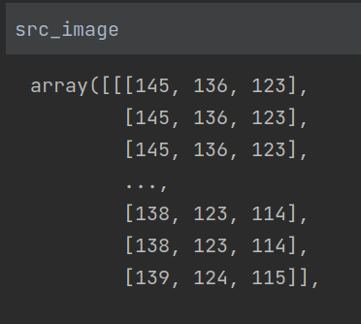

Slide 3
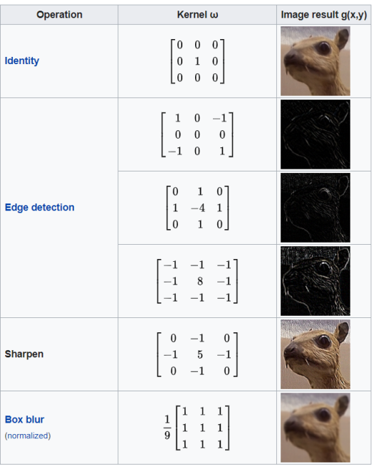
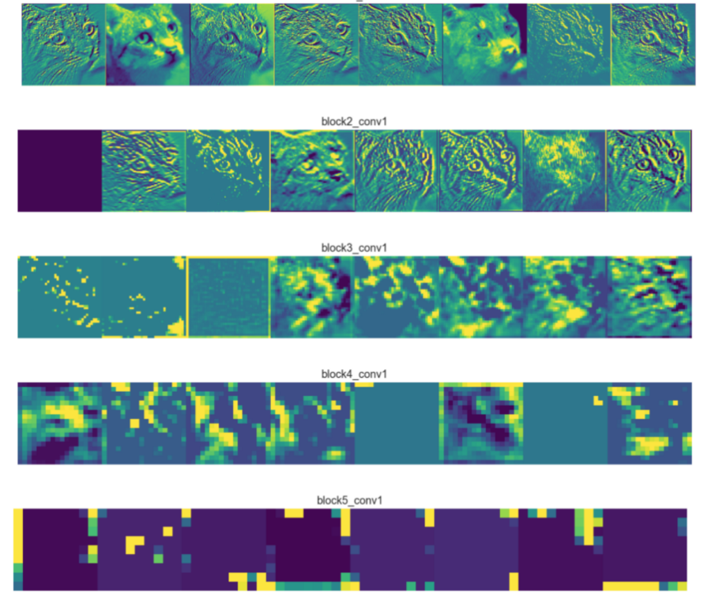

Slide 4
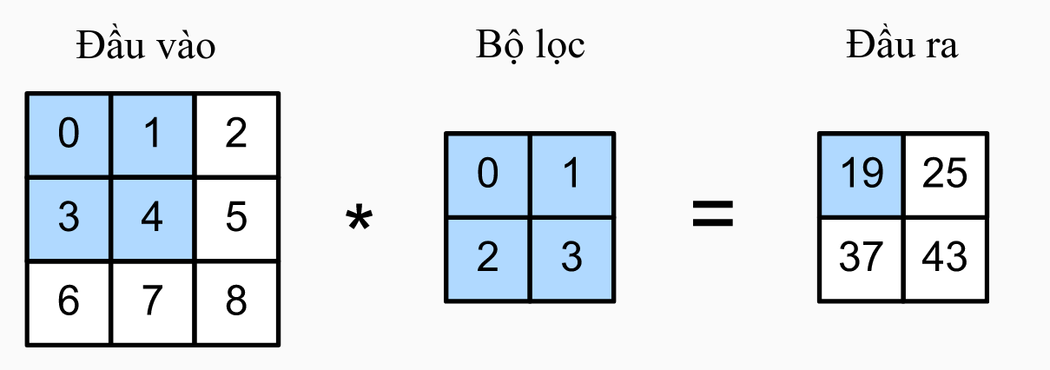
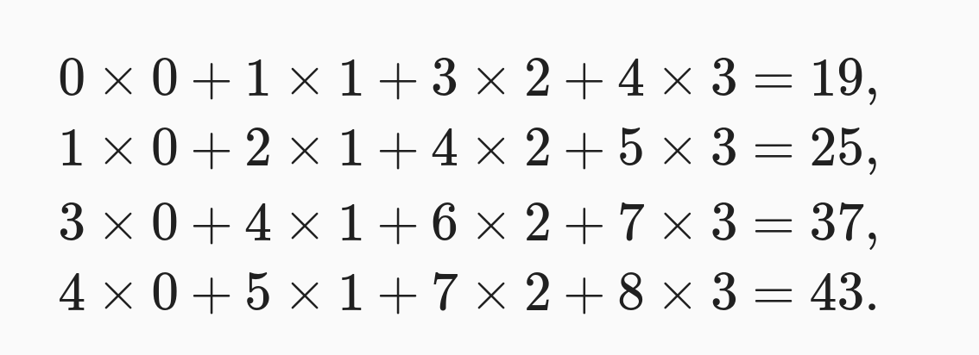
m*n
k*k
(m-k+1)*(n-k+1)

